Slide 1


Lab Study 9
석사과정 장명준

Slide 2
CONTENTS
1. Show and Tell : A Neural Image Caption Generator
2. Show, Attend and Tell : Neural Image Caption Generation with Visual Attention
3. DenseCap: Fully Convolutional Localization Networks for Dense Captioning

Slide 3
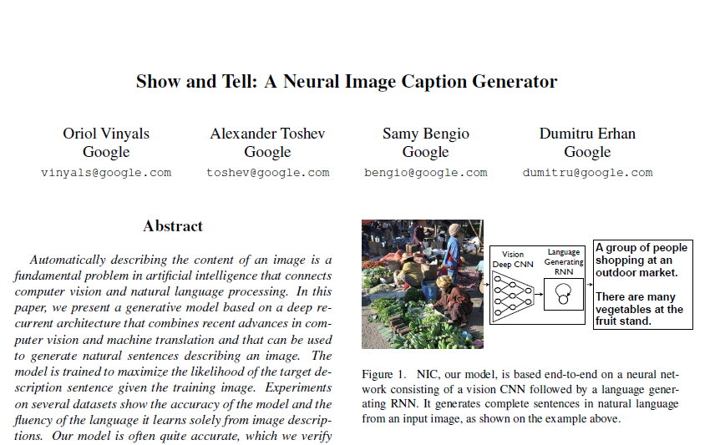
Show and Tell
Show, Attend and Tell
Densecap

Slide 4
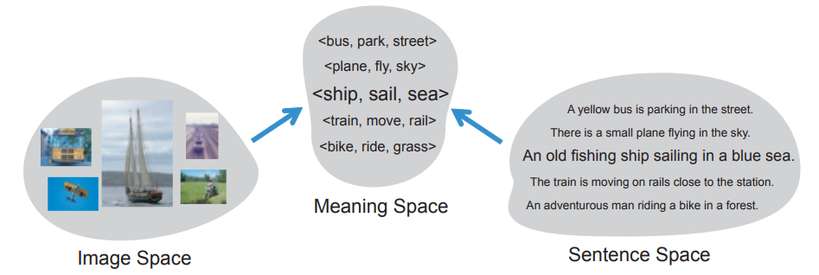
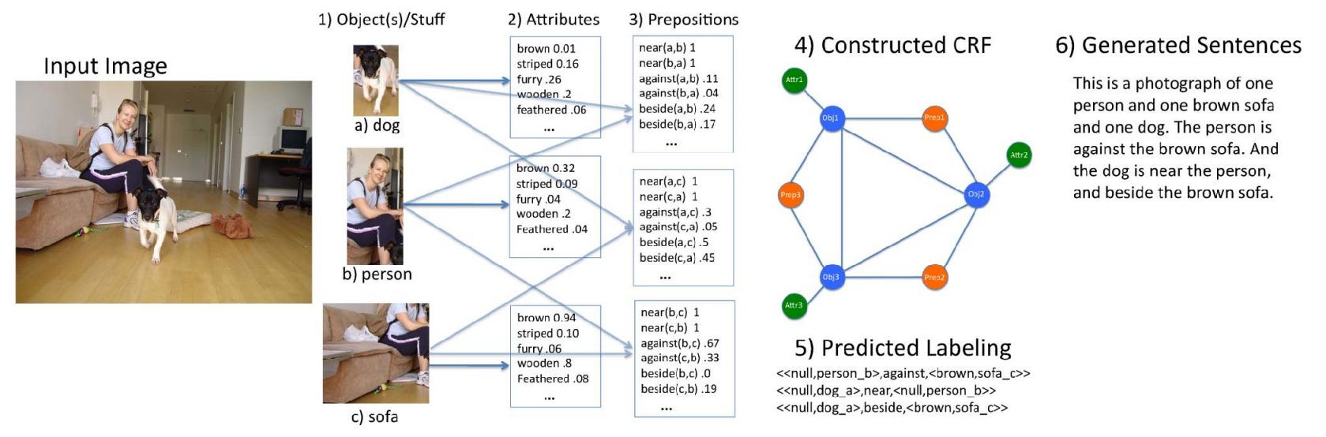
Show and Tell
Show, Attend and Tell
Densecap
1) Idea
Related work 1.
- Farhadi et al, “Every Picture Tells a Story: Generating Sentences from Images”, In ECCV, 2010
- Assume there exist meaning space between Image & Sentence
- Meaning Space : <object, action, scene>
- Calculate similarity between Image-Meaning, Meaning-Sentence and mapping
Related work 2.
- Kulkarni et al, “BabyTalk: Understanding and Generating Simple Image Descriptions”, In CVPR, 2011
Problems
- Not enough data set (work 1)
- Rely on hard-coded visual concept & sentence templates
- Cause on the variety of model

Slide 5
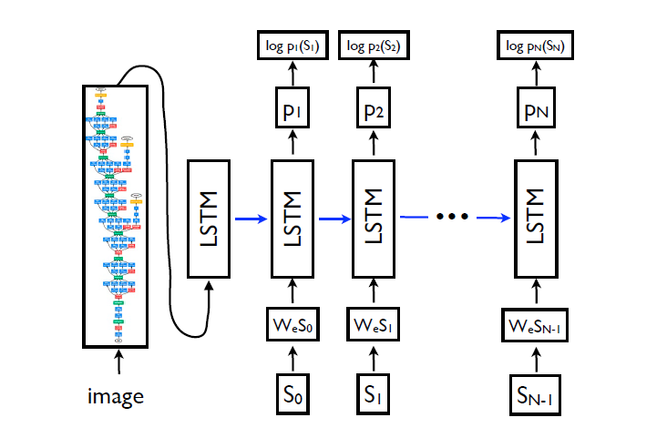
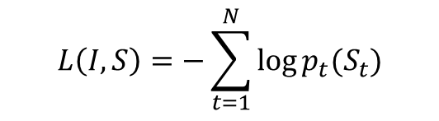
Show and Tell
Show, Attend and Tell
Densecap
2) Model structure
- Training
embedded
One-hot
$$L\left(I,S\right)=−\sum_{t=1}^{N}{log⁡p_{t}(S_{t})}$$

Slide 6
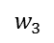

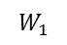
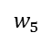

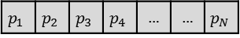
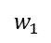
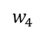
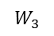

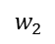
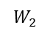
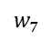

Show and Tell
Show, Attend and Tell
Densecap
2) Model structure
- Testing
Sampling
$$p_{1}$$ | $$p_{2}$$ | $$p_{3}$$ | $$p_{4}$$ | … | … | $$p_{N}$$
Sampling word
Beam Search
$$w_{7}$$
$$P=P{(w}_{1})×P{(w}_{5})×P{(w}_{7})$$
$$w_{5}$$
$$w_{2}$$
$$P=P{(w}_{1})×P{(w}_{5})×P{(w}_{2})$$
$$w_{1}$$
Beam size: 2
$$w_{2}$$
$$P=P{(w}_{1})×P{(w}_{3})×P{(w}_{2})$$
$$w_{3}$$
$$w_{4}$$
$$P=P{(w}_{1})×P{(w}_{3})×P{(w}_{4})$$
$$W_{1}$$
$$W_{2}$$
$$W_{3}$$

Slide 7
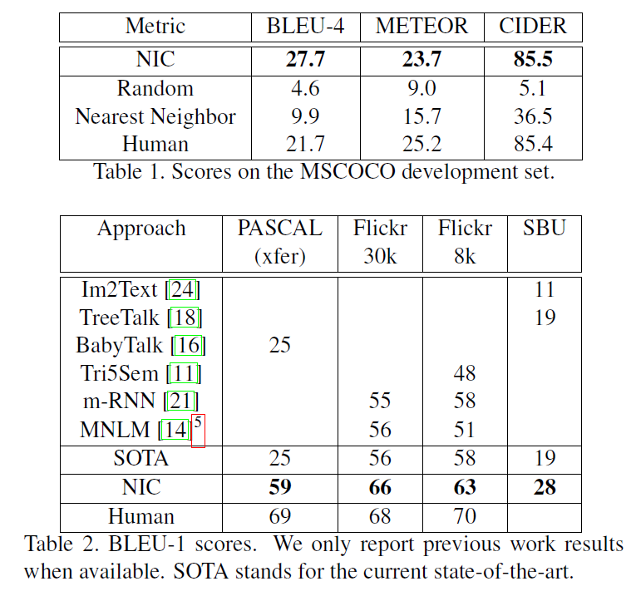
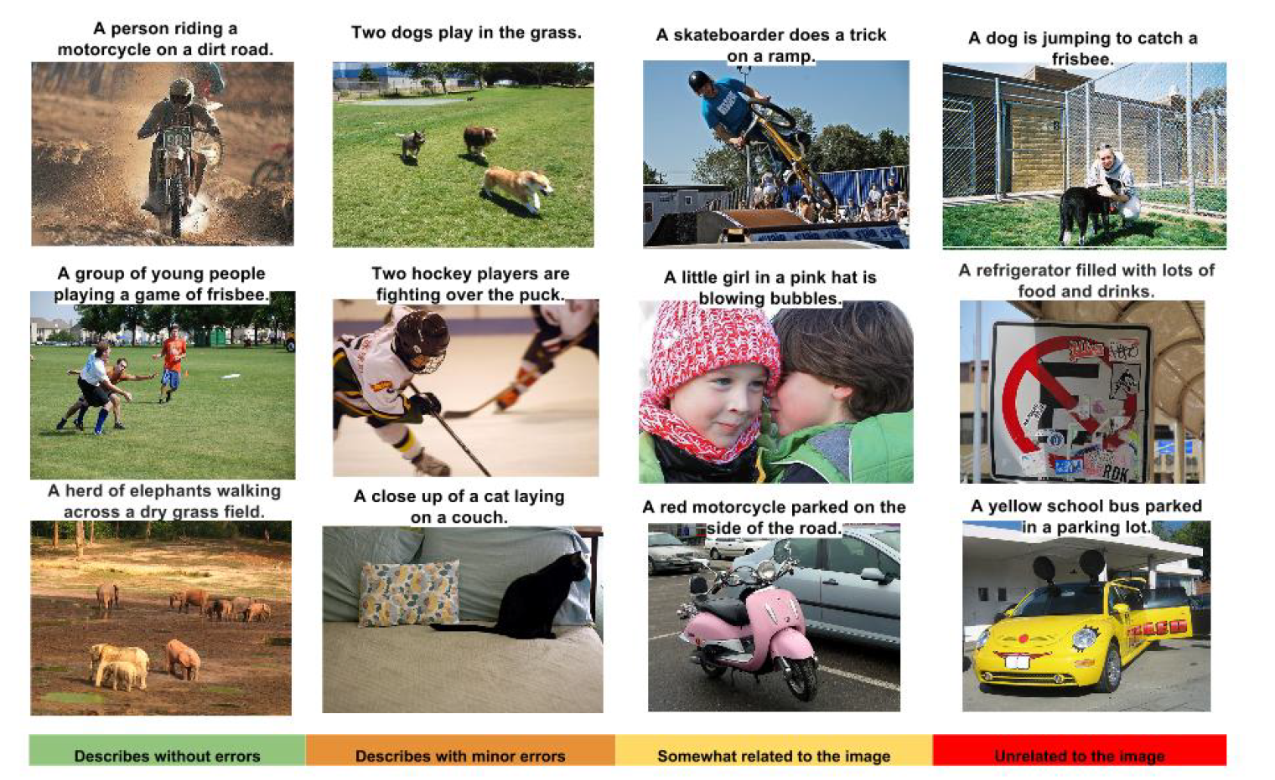
Show and Tell
Show, Attend and Tell
Densecap
3) Performance
1. BLEU score
2. Human evaluation

Slide 8
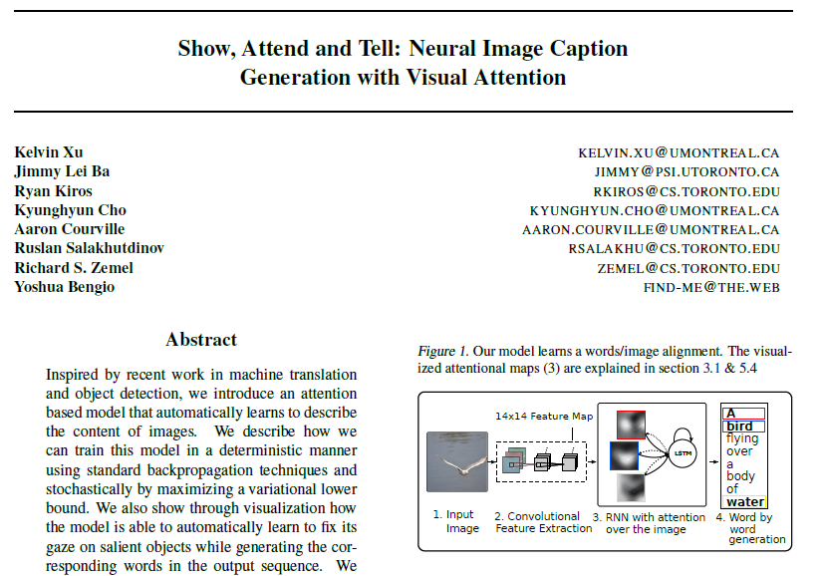
Show and Tell
Show, Attend and Tell
Densecap

Slide 9
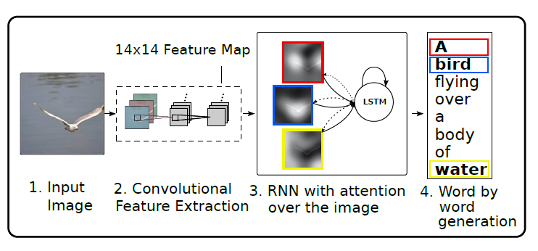
Show and Tell
Show, Attend and Tell
Densecap
1) Idea
Rather than compress an entire image, use salient features
Drawback : losing information which could be useful for richer, more descriptive captions

Slide 10
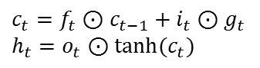
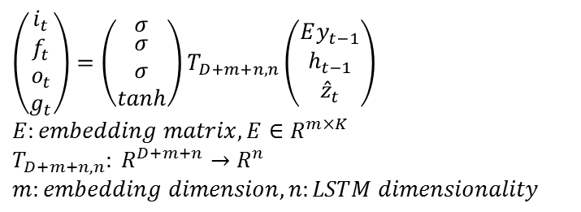
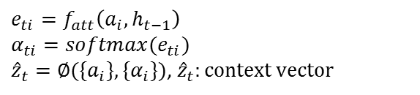
Show and Tell
Show, Attend and Tell
Densecap
2) Model
1. Structure
$y_{i}:generated caption$(one-hot encoding)
$$y=\left\{y_{1},…,y_{C}\right\},y_{i}∈R^{K}, K:size of vocabulrary, C:length of the caption$$
$$a_{i}:representation corresponding to a part of the image(feature map)$$
$$a=\left\{a_{1},…,a_{L}\right\},a_{i}∈R^{D}$$
LSTM model
$$\left(\begin{matrix}i_{t} \\ \begin{matrix}f_{t} \\ o_{t} \\ g_{t}\end{matrix}\end{matrix}\right)=\left(\begin{matrix}σ \\ \begin{matrix}σ \\ σ \\ tanh\end{matrix}\end{matrix}\right)T_{D+m+n,n}\left(\begin{matrix}Ey_{t−1} \\ h_{t−1} \\ {\hat{z}}_{t}\end{matrix}\right)$$
$$E:embedding matrix, E∈R^{m×K}$$
$$T_{D+m+n,n}: R^{D+m+n}→R^{n}$$
$$m:embedding dimension, n:LSTM dimensionality$$
$$c_{t}=f_{t}⊙c_{t−1}+i_{t}⊙g_{t}$$
$$h_{t}=o_{t}⊙tanh⁡(c_{t})$$
$$e_{ti}=f_{att}\left(a_{i},h_{t−1}\right)$$
$$α_{ti}=softmax(e_{ti})$$
${\hat{z}}_{t}=∅(\{a_{i}\},\{α_{i}\})$, ${\hat{z}}_{t}:context vector$

Slide 11
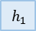
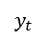
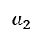

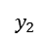
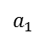

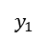

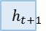
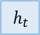
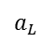
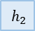
Show and Tell
Show, Attend and Tell
Densecap
2) Model
1. Structure
Image
CNN
$$a_{L}$$
$$a_{2}$$
$$e_{ti}=f_{att}(a_{i},h_{t−1})$$
$$a_{1}$$
$$α_{ti}=softmax(e_{ti})$$
$${\hat{z}}_{t}=∅(\left\{a_{i}\right\},\{α_{i}\})$$
LSTM
LSTM
LSTM
LSTM
$$y_{1}$$
$$y_{2}$$
$$y_{t}$$
$$h_{1}$$
$$h_{2}$$
$$h_{t}$$
$$h_{t+1}$$
$$p\left(y_{t} | a,y_{t−1}\right)∝exp⁡(L_{o}(Ey_{t−1}+L_{h}h_{t}+L_{z}{\hat{z}}_{t}))$$

Slide 12

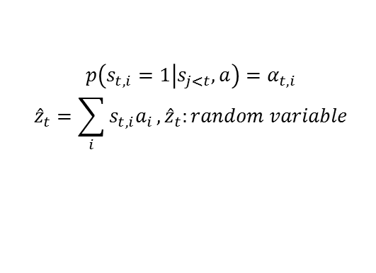
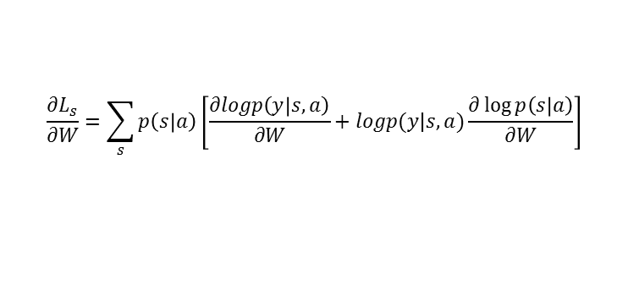
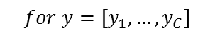
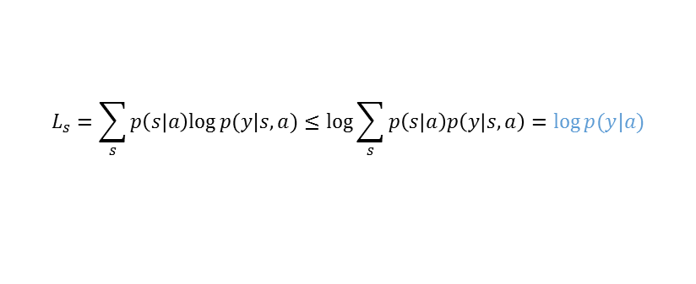

Show and Tell
Show, Attend and Tell
Densecap
2) Model
2. Attention
1) Stochastic Hard Attention
$$s_{t}:location variable, where the model decides to focus attention when generating the t^{th} word$$
$$s_{t,i}=1 if the i th location is used to extract visual feature$$
$$ex) s_{1}=[0,0,1,0,…,0]$$
$$p\left(s_{t,i}=1 | s_{j<t},a\right)=α_{t,i}$$
$${\hat{z}}_{t}=\sum_{i}{s_{t,i}a_{i}},{\hat{z}}_{t}:random variable$$
$$for y=[y_{1},…,y_{C}]$$
$$L_{s}=\sum_{s}{p\left(s | a\right)log⁡p(y|s,a)}≤log⁡\sum_{s}{p\left(s | a\right)p\left(y | s,a\right)=log⁡p(y|a)}$$
$$\log{p\left(y | a\right)}=\log{p\left(y_{1} | a,y_{0}\right)}×p\left(y_{2} | a,y_{1}\right)…×p(y_{C}|a,y_{C−1})$$
$$\frac{∂L_{s}}{∂W}=\sum_{s}{p\left(s | a\right)\left[\frac{∂logp\left(y | s,a\right)}{∂W}+logp(y|s,a)\frac{∂\log{p\left(s | a\right)}}{∂W}\right]}$$
$${\tilde{s}}_{t}\sim {Multinouli}_{L}(\{α_{i}\})$$
$$\frac{∂L_{s}}{∂W}=\frac{1}{N}\sum_{n=1}^{N}{\left[\frac{∂logp\left(y | s^{\sim n},a\right)}{∂W}+logp(y|s^{\sim n},a)\frac{∂\log{p\left(s^{\sim n} | a\right)}}{∂W}\right]}$$

Slide 13
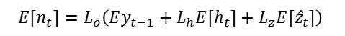

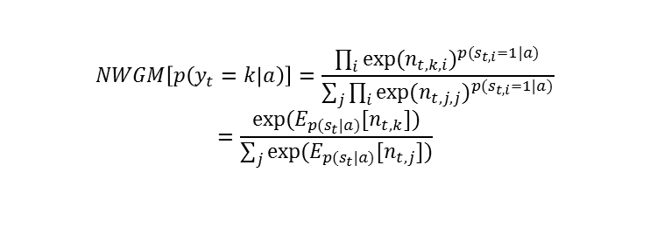
Show and Tell
Show, Attend and Tell
Densecap
2) Model
2. Attention
2) Deterministic Soft Attention
$$Instead of sampling s_{t} for each time, take expectation of the context vector {\hat{z}}_{t}$$
$$E_{p(s_{t}|a)}[{\hat{z}}_{t}]=\sum_{i=1}^{L}{α_{t,i}a_{i}}$$
$$h_{t} is a linear projection of the {\hat{z}}_{t} followed by\tanh{non−linearity}$$
$$∴calculating E_{p(s_{t}|a)}[h_{t}]≅E_{p(s_{t}|a)}[{\hat{z}}_{t}]$$
$$let n_{t}=L_{o}\left(Ey_{t−1}+L_{h}h_{t}+L_{z}{\hat{z}}_{t}\right),$$
$$n_{t,i} denotes n_{t} computed by setting the random variable \hat{z} value to a_{i}$$
$$the normalized weighted geometric mean for softmax k^{th} word is$$
$$NWGM\left[p\left(y_{t}=k | a\right)\right]=\frac{\prod_{i}{{exp⁡(n_{t,k,i})}^{p(s_{t,i}=1|a)}}}{\sum_{j}{\prod_{i}{{exp⁡(n_{t,j,j})}^{p(s_{t,i}=1|a)}}}}$$
$$=\frac{exp⁡(E_{p(s_{t}|a)}[n_{t,k}])}{\sum_{j}{exp⁡(E_{p(s_{t}|a)}[n_{t,j}])}}$$
$$E[n_{t}]=L_{o}\left(Ey_{t−1}+L_{h}E[h_{t}]+L_{z}E[{\hat{z}}_{t}]\right)$$
Expectation of the outputs over all possible attention locations induced by random variable $s_{t}$ is computed by simple feedforward propagation with expected context vector

Slide 14
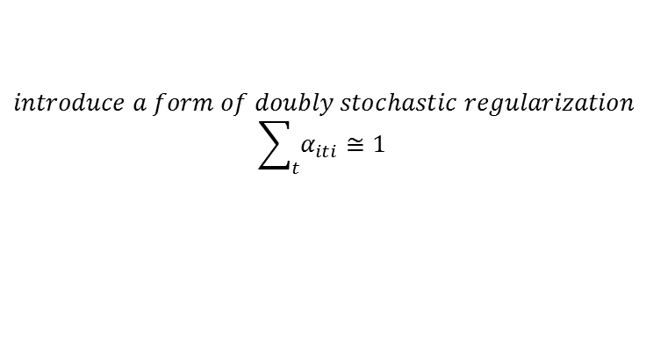
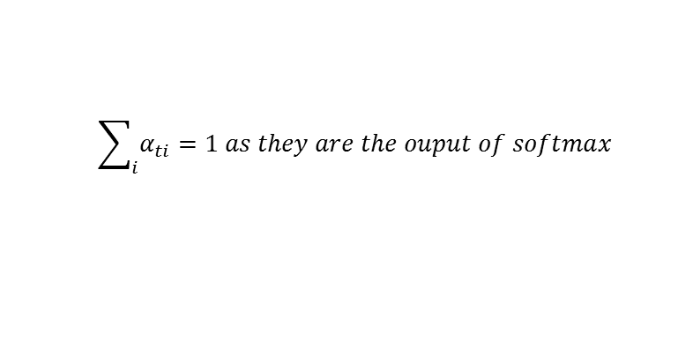
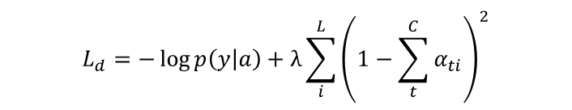
Show and Tell
Show, Attend and Tell
Densecap
2) Model
2. Attention
2) Deterministic Soft Attention
$$\sum_{i}{α_{ti}}=1 as they are the ouput of softmax$$
$$introduce a form of doubly stochastic regularization$$
$$\sum_{t}{α_{iti}}≅1$$
This can be interpreted as encouraging the model to pay equal attention to every part of the image over the course of generation
Improve overall BLEU score and leads to more rich and descriptive captions
$$L_{d}=−\log{p\left(y | a\right)}+λ\sum_{i}^{L}{{\left(1−\sum_{t}^{C}{α_{ti}}\right)}^{2}}$$

Slide 15
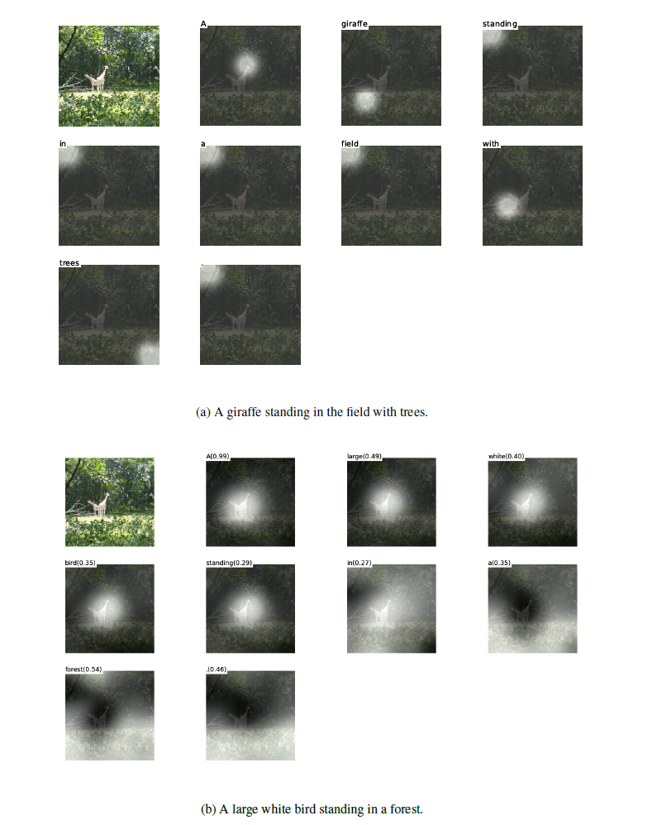
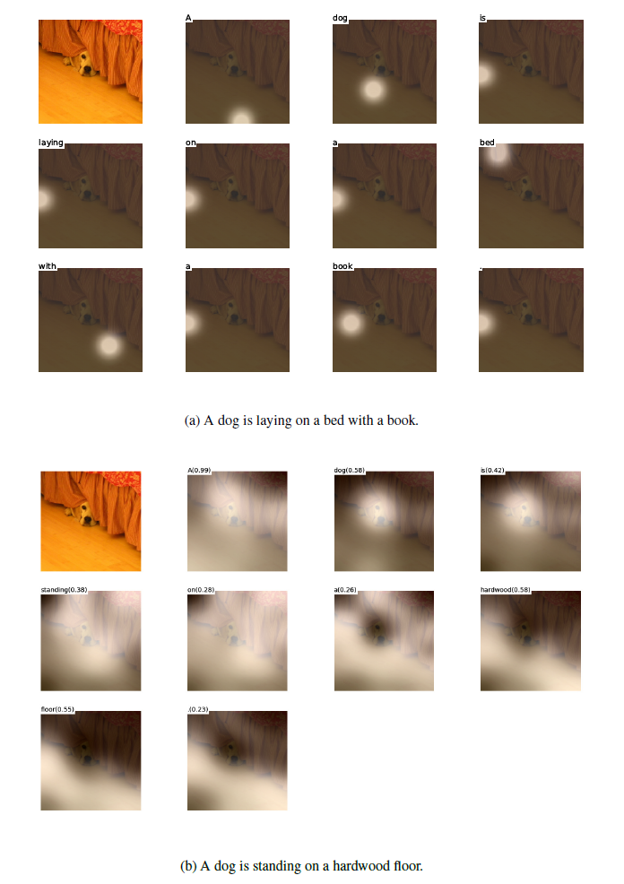
Show and Tell
Show, Attend and Tell
Densecap
2) Result

Slide 16
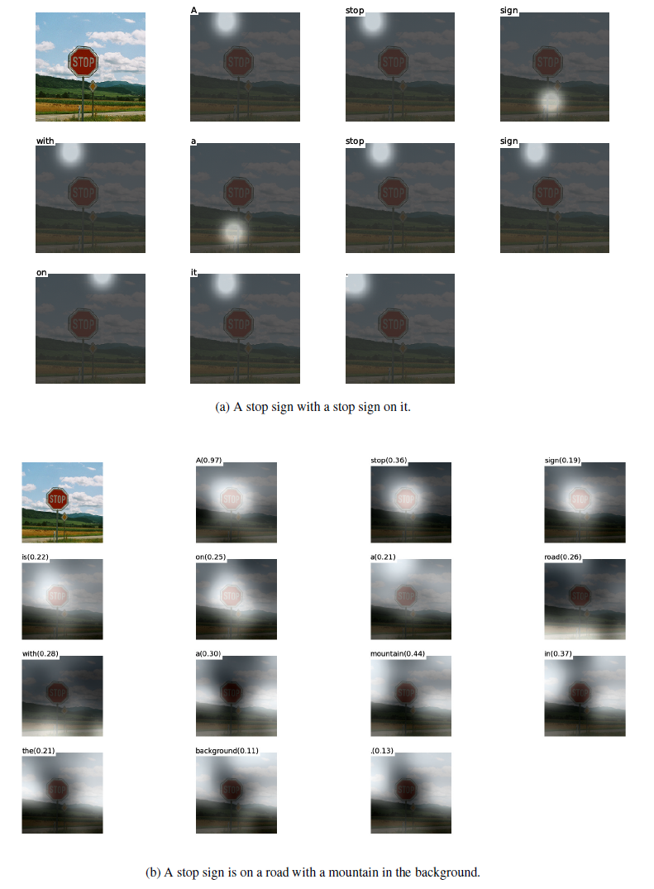
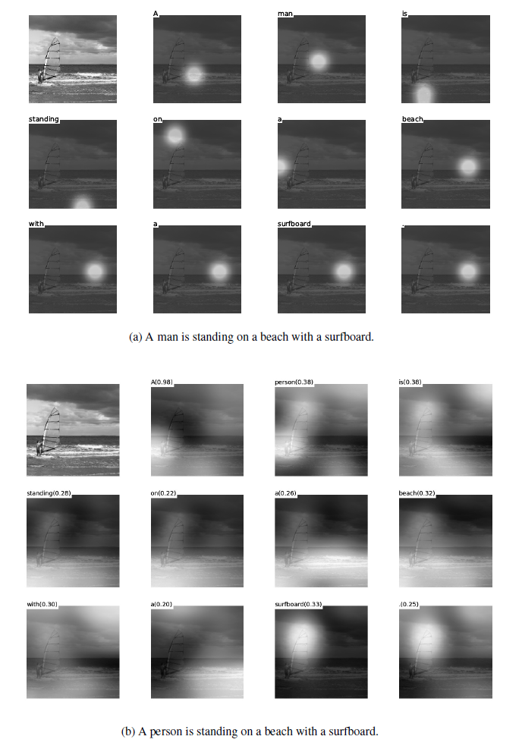
Show and Tell
Show, Attend and Tell
Densecap
2) Result

Slide 17
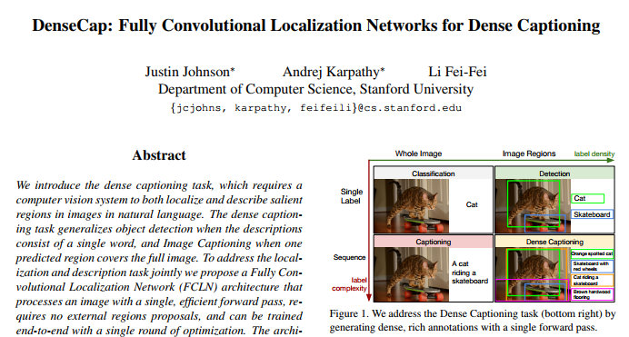
Show and Tell
Show, Attend and Tell
Densecap

Slide 18
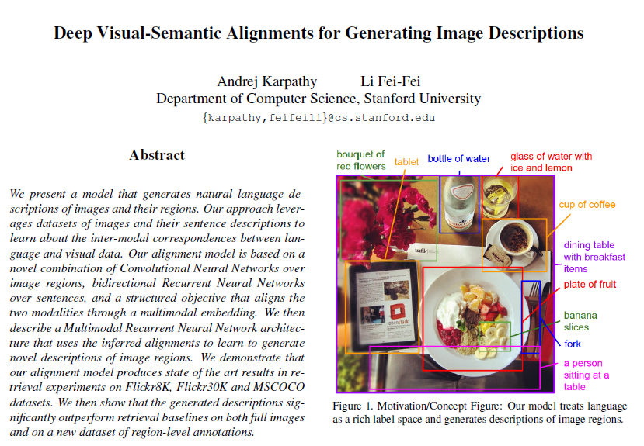
Show and Tell
Show, Attend and Tell
Densecap
1) Idea
- To improve previous work

Slide 19
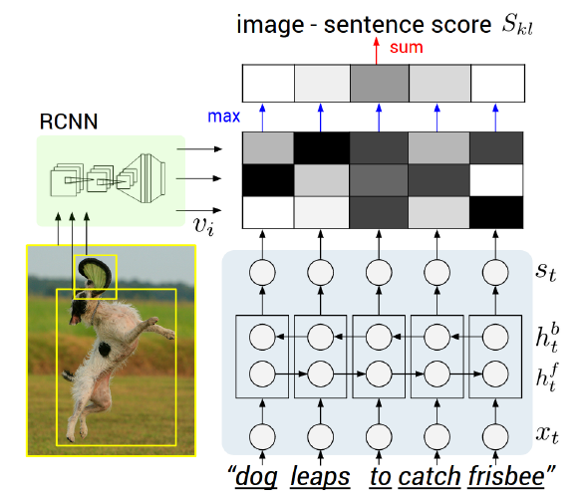
Show and Tell
Show, Attend and Tell
Densecap
1) Idea
- To improve previous work
Step 1)
Step 2)

Slide 20
Show and Tell
Show, Attend and Tell
Densecap
1) Idea
- To improve previous work
1. No Context
The prediction does not include context outside of each region
2. Inefficient
We must forward every region independently
3. Not end-to-end
There are two models trained separately

Slide 21
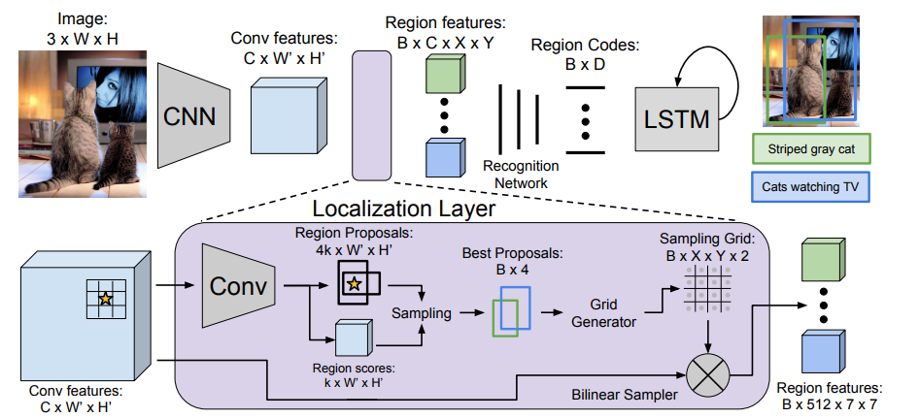
Show and Tell
Show, Attend and Tell
Densecap
2) Model structure
Convolutional Network : VGG 16

Slide 22
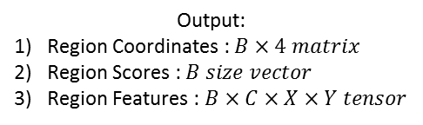
Show and Tell
Show, Attend and Tell
Densecap
2) Model structure
Input:
Tensor of activations
Output:
Region Coordinates : $B×4 matrix$
Region Scores : $B size vector$
Region Features : $B×C×X×Y tensor$
Fast R-CNN structure
ROI pooling
Conv features
Max pool
- Gradients are propagated backward from the output features to the input features, but not to the input proposal coordinates

Slide 23






Show and Tell
Show, Attend and Tell
Densecap
2) Model structure
Input:
Tensor of activations
Output:
Region Coordinates : $B×4 matrix$
Region Scores : $B size vector$
Region Features : $B×C×X×Y tensor$
$$G(x_{i,j},y_{i,j})$$
$$V_{c,i,j}=\sum_{i^{′}=1}^{W}{\sum_{j^{′}=1}^{H}{U_{c,i^{′},j^{′}}k(i^{′}−x_{i,j})k(j^{′}−y_{i,j})}}$$
$$k\left(d\right)=max⁡(0,1−\left|d\right|)$$
$$\frac{∂V_{c,i,j}}{∂U_{c,i^{′},j^{′}}}=\sum_{i^{′}=1}^{W}{\sum_{j^{′}=1}^{H}{max(0,1−\left|i^{′}−x_{i,j}\right|)max(0,1−\left|j^{′}−y_{i,j}\right|)}}$$
$$\frac{{∂V}_{c,i,j}}{∂x_{i,j}}=\sum_{i^{′}=1}^{W}{\sum_{j^{′}=1}^{H}{U_{c,i^{′},j^{′}}max(0,1−\left|j^{′}−y_{i,j}\right|)}}\left\{\begin{matrix}0 if\left|i^{′}−x_{i,j}\right|≥1 \\ 1 if i^{′}≥ x_{i,j} \\ −1 if i^{′}≤ x_{i,j}\end{matrix}\right.$$
$$\frac{{∂V}_{c,i,j}}{∂y_{i,j}}=\sum_{i^{′}=1}^{W}{\sum_{j^{′}=1}^{H}{U_{c,i^{′},j^{′}}max(0,1−\left|i^{′}−x_{i,j}\right|)}}\left\{\begin{matrix}0 if\left|j^{′}−y_{i,j}\right|≥1 \\ 1 if j^{′}≥ y_{i,j} \\ −1 if j^{′}≤ y_{i,j}\end{matrix}\right.$$

Slide 24
Show and Tell
Show, Attend and Tell
Densecap
2) Model structure
D=4096
Flatten
B
Output 1
B
5(confidence, coordinates)
Linear transformation
FC layer
B
Output 2

Slide 25






Show and Tell
Show, Attend and Tell
Densecap
2) Model structure
END
$$s_{t}$$
sampling
sampling
$$W_{oh}$$
B
$$W_{hh}$$
$$h_{t}$$
$$W_{hx}$$
D
$$x_{t}$$
STRAT

Slide 26




Show and Tell
Show, Attend and Tell
Densecap
2) Model structure
Loss function
$${Loss}_{conf}=binary logistic loss$$
$${Loss}_{loc}=smooth L1 loss$$
$${Loss}_{language}=cross entropy loss$$
$${Loss}_{Total}={Loss}_{language}+0.1\left({Loss}_{conf,local,1}+{Loss}_{loc,local,1}\right)+0.1({Loss}_{conf,recog,2}+{Loss}_{loc,recog,2})$$

Slide 27

Show and Tell
Show, Attend and Tell
Densecap
3) Result

Slide 28


